Slide 1
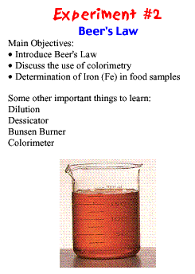
Introduction to Beer’s Law Experiment
… and other applications
Original site: http://www.chem.unc.edu/undergrads/2001fall/chem11l_austell/c11l_lec2.pdf

Slide 2
A Little College Humor

Slide 3
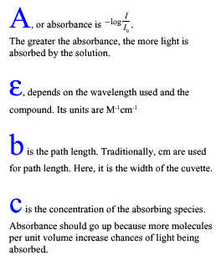
Answers to 2003 AP Exam Free-Response Question 5d
This Beer’s Law expression and the identification of its variables are now included on the CB equations and constants page, which students are allowed to use while taking the AP Chemistry Exam.

Slide 4
Practical Applications of Beer’s Law
Beer’s Law: Don’t drink and drive!!!

Slide 5
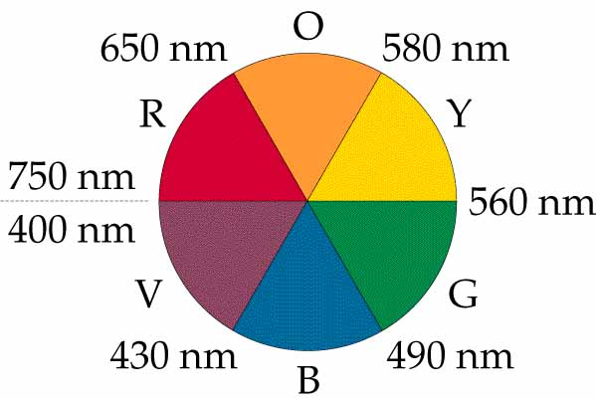
How a Spectrophotometer Works
Artist’s Color Wheel

Slide 6
Lab Application of Beer’s Law

Slide 7
Using a Colorimeter
A colorimeter has a set number of LEDs that produce only very specific wavelengths that can be passed through a solution.
The wavelength selected for a particular sample should be on the opposite side of the color wheel in order for the solution to absorb it well.
Try each wavelength with your solution to measure the absorbances, then select the LED that produces the highest value.
Place a cuvette filled with distilled water (called a blank) in the chamber, then calibrate the colorimeter.
Measure the absorbance of each sample and plot it versus its concentration (Beer’s Law).
Wavelengths: 430 nm, 470 nm, 565 nm, 635 nm Connections: Wireless: Bluetooth
Wired: USB

Slide 9
Using a Spectrophotometer
Capable of connecting wirelessly or by USB, this device can easily collect a full wavelength spectrum (absorbance, percent transmission, or intensity) in less than one second.
Determine peak wavelength to collect data on solution concentration for studies of Beer’s law or to monitor rates of reaction.
Wavelength Range: 380 nm–950 nm Support for fluorescence: Two excitation sources centered at 405 nm and 500 nm

Slide 10
To find the absorbance, use A = εbc , where the path length, b = 1cm, and at a wavelength of 635 nm, ε = 1.38E5
c = A/εb
= 0.645/1.38E5
= 4.67E-6 M

